Slide 1

SAL 603 Final Project
By: Jason Leslie
By: Reginald Archer & Jason Leslie

Slide 2

Research Question
Is the non-contact soft tissue injury rate higher during preseason compared to regular season?

Slide 3

Injury Classifications
1) Non-contact soft tissue
2) Contact soft tissue
3) Concussion
4) Meniscus/ Labral Pathology
5) Fracture/ Dislocation
6) Overuse
7) Other
Notes:
Soft tissue = muscle, tendon, ligaments
Meniscus = cartilage that supports the joints
Why separate injuries by classification? It is believed that non- contact injuries are caused from intrinsic factors that can be prevented through strength and condition and proper training

Slide 4
Injury Classifications
Injury Type | Injury Location | Mechanism of Injury | Severity of injury(days missed)
Concussion Contusion Dislocation Fracture/avulsion Laceration Ligament sprain Muscle/tendon strain Other | Head/Face Neck Shoulder/clavicle Arm/elbow Hand/Wrist Hip Thigh/upper leg Knee Lower leg Ankle Foot Other | Contact Non-contact Overuse | < 1 week 1 to 3 weeks > 3 weeks
Notes:
7 classifications are derived from a multitude of different ways a person can get injured. To conduct a meaningful analysis grouped distributions using the 7 classifications was used

Slide 5
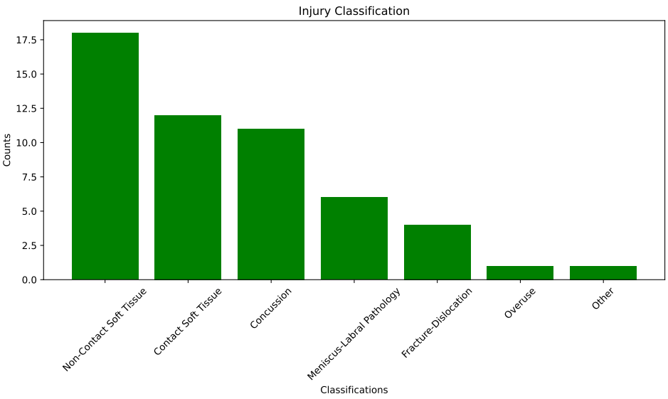
Frequency Distribution
Notes:
Distribution of injury classification is shown above NC-ST(n=18), C-ST(n=12), Concussions(n=11), Meniscus / Labral Pathology (n=6), Fracture / Dislocation (n=4) , overuse (n=1), other (n=1)

Slide 6
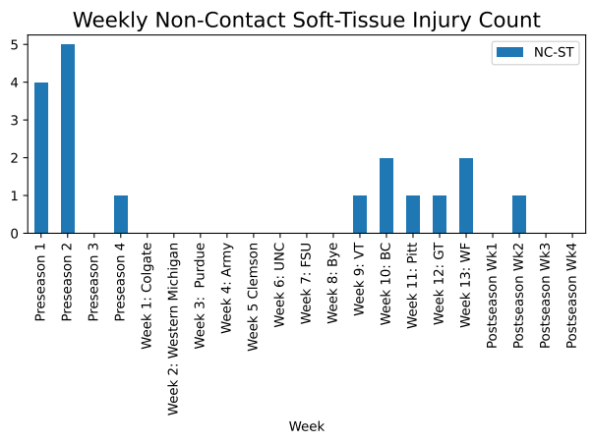
Non-Contact Injuries
Notes:
From Week to week pesceptive this bar graph shows NC-ST trends really well. Highlight preseason spike and uptick after bye

Slide 7
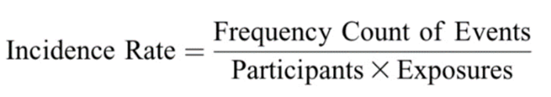
Calculating Injury Rate
•Incidence: is the number of new cases of injuries in a population during a time period
•Can be expressed as a risk or injury rate.
•Injury rate: a descriptor of number of events that occur per participant in a given timeframe

Slide 8
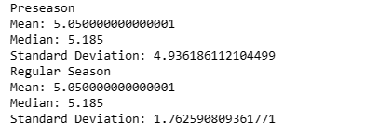

Measures of Central Tendency & Variability(Rates)
Using the quantitative summary of the groups characteristics, we can describe the nature of the data and difference among the weekly injury rates.
Because the means are similar, it indicates that the regular season injury rate was clustered closer to the mean than the preseason
Notes:
To truely compare preseason to regular season IR

Slide 9
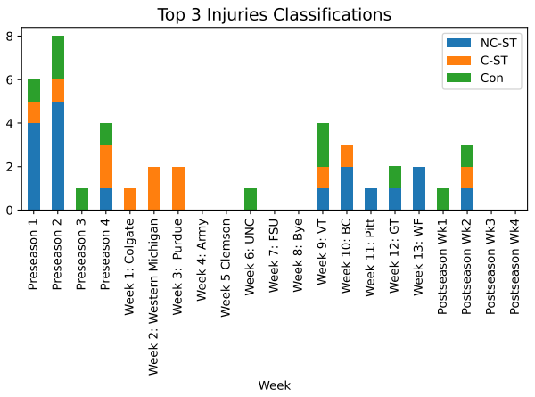
Injury Classifications by Week
Notes:
Distribution of injury classification is shown above NC-ST(n=18), C-ST(n=12), Concussions(n=11), Meniscus / Labral Pathology (n=6), Fracture / Dislocation (n=4) , overuse (n=1), other (n=1)

Slide 10
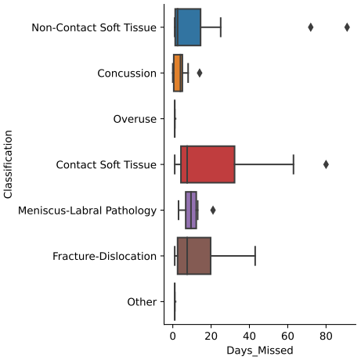
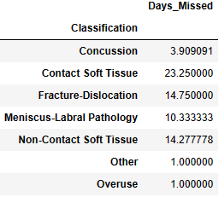
Injury Severity by Classification
Overall, C-ST injuries resulted in greater total / average days missed than NC-ST

Slide 11
Summary
Injury Rates for NC-ST were relatively the same between the two time frames of the season
NC-ST injuries occurred the most during the season, but C-ST injuries had higher avg/ total days missed
Important to note that we compared injury rates, not injury occurs in our research question. The rate of injury is influenced by athlete exposure
Notes:
Distribution of injury classification is shown above NC-ST(n=18), C-ST(n=12), Concussions(n=11), Meniscus / Labral Pathology (n=6), Fracture / Dislocation (n=4) , overuse (n=1), other (n=1)

